Slide 1
Transport
Layer
Protocols

Slide 2
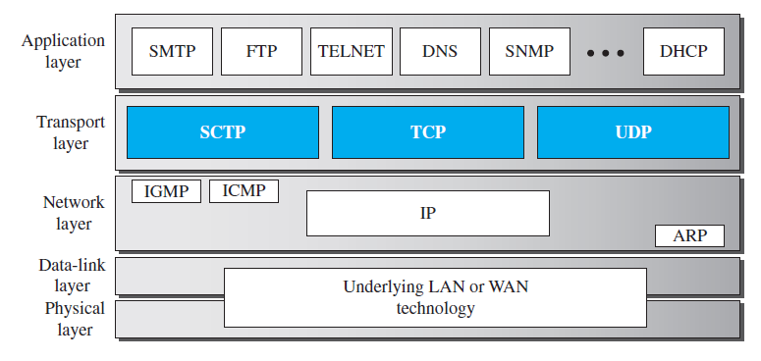
TCP/IP protocol suite
Stream Control Transmission Protocol

Slide 3
Services
Each protocol provides different types of service and should be used appropriately
UDP : UDP is an unreliable connectionless transport-layer protocol. Simple and efficient. Application layer takes care of error control
TCP : TCP is a reliable connection-oriented protocol. Used where reliability is important.
SCTP : SCTP is a new transport-layer protocol that combines the features of UDP and TCP

Slide 4
Port Numbers
Transport layer protocol responsibilities
One is to create a process-to-process communication. These protocols use port numbers to accomplish this.
Port numbers provide end-to-end addresses at the transport layer and allow multiplexing and demultiplexing at this layer

Slide 5
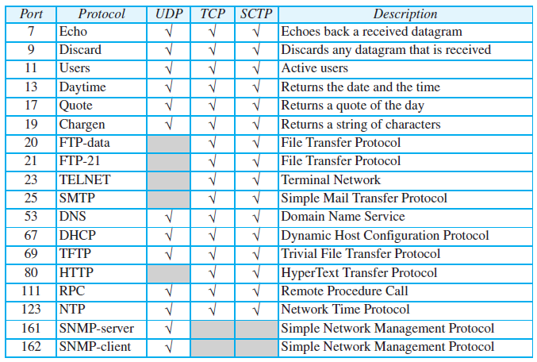
Some well-known ports used with UDP and TCP

Slide 6
USER DATAGRAM PROTOCOL
The User Datagram Protocol (UDP) is a connectionless, unreliable transport protocol.
Provides process to process communication instead of host to host communication.
If UDP is powerless, why would a process want to use it?
UDP is a very simple protocol using a minimum of overhead. Process can send a small message, does not care much about reliability
UDP takes much less interaction between the sender and receiver.

Slide 7
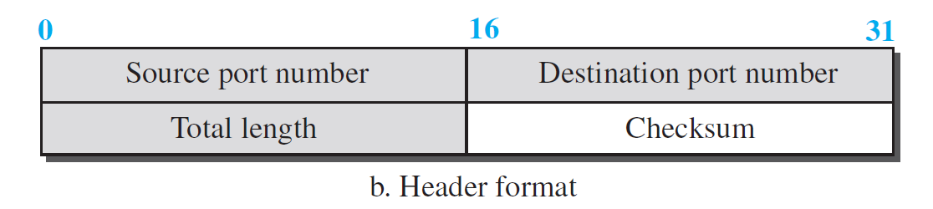
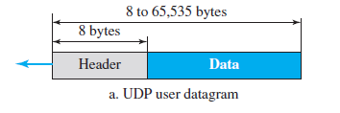
User Datagram
UDP packets, called user datagrams.
8 Byte fixed size header made of 4 fields.
First two fields define the source and destination port numbers.
Third field is total length of user datagram.
Fourth field is check sum

Slide 8
Example 24.1
The following is the content of a UDP header in hexadecimal format : CB84000D001C001C.
  a. What is the source port number?
  b. What is the destination port number?
  c. What is the total length of the user datagram?
  d. What is the length of the data?
  e. Is the packet directed from a client to a server or vice versa?
  f. What is the client process?

Slide 9
Solution
  The source port number is the first four hexadecimal digits (CB84)₁₆, which means that the source port number is 52100.
  The destination port number is the second four hexadecimal digits (000D)₁₆, which means that the destination port number is 13.
  The third four hexadecimal digits (001C)₁₆ define the length of the whole UDP packet as 28 bytes.
  The length of the data is the length of the whole packet minus the length of the header, or 28 − 8 = 20 bytes.
CB84000D001C001C

Slide 10
Solution
e. Since the destination port number is 13 (well-known port), the packet is from the client to the server.
f. The client process is the Daytime (see Table 24.1).

Slide 11
UDP Services
Process-to-Process Communication.
Connectionless Services
Flow Control
Error Control
Checksum
Congestion Control
Encapsulation and Decapsulation.
Queuing
Multiplexing and Demultiplexing

Slide 12
UDP services
Process-to-Process Communication: Using socket addresses, a combination of IP addresses and port numbers.
Connectionless Services : Each user datagram sent by UDP is an independent datagram. User datagram are not numbered.
Flow Control : No flow control, and hence no window mechanism. Receiver may overflow.
Error Control : No error control mechanism in UDP except the checksum. Sender does not know if a message has been lost or duplicated

Slide 13
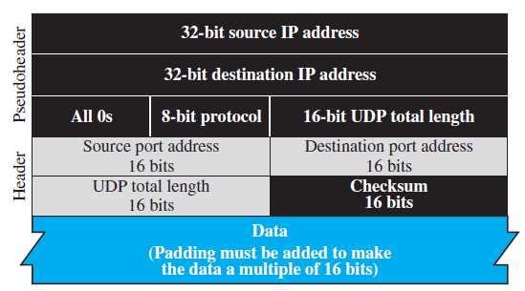
Checksum
UDP checksum calculation need three fields.
  Pseudo header
  UDP header
  Data coming from the application layer.

Slide 14
UDP services
Congestion Control: No congestion control. It assume the packets are very small and can’t create congestion.
Encapsulation and Decapsulation : To send a message from one process to another, UDP encapsulates the message and decapsulates.
Queuing: When a process starts, it requests a port number from the OS. Creates incoming and outgoing queue associated with each process.
Multiplexing and demultiplexing: Several process may share the services of UDP

Slide 15
UDP Features
Connectionless Service:
  UDP packet is independent.
  An advantage or disadvantage depending on the application requirements.
  Ex. A client application needs to send a short request to a server and to receive a short response.
  In the connection oriented service, at least 9 packets are exchanged between the client and the server; in connectionless service only 2 packets are exchanged.

Slide 16
Lack of Error Control
UDP does not provide error control.
It provides an unreliable service.
Some applications, by nature, do not even notice these uneven delays, but for some they are very problematic.
Lack of Congestion Control : UDP does not provide congestion control.

Slide 17
Typical Applications
Benefit more from the services of UDP than from those of TCP.
UDP is suitable for a process that requires simple request-response communication with little concern for flow and error control.
UDP is suitable for a process with internal flow-control and error-control mechanisms.
  For example, the Trivial File Transfer Protocol (TFTP) process includes flow and error control. It can easily use UDP.
UDP is a suitable transport protocol for multicasting. UDP is used for management processes such as SNMP
UDP is used for some route updating protocols such as Routing Information Protocol (RIP) .
UDP is normally used for interactive real-time applications.

Slide 18
TRANSMISSION CONTROL PROTOCOL
Transmission Control Protocol (TCP) is a connection-oriented, reliable protocol.
TCP explicitly defines connection establishment, data transfer, and connection teardown phases to provide a connection-oriented service.
TCP uses checksum (for error detection), retransmission of lost or corrupted packets, cumulative and selective acknowledgments, and timers.
TCP is the most common transport-layer protocol in the Internet.

Slide 19
TCP Services
Process-to-Process Communication (Same as UDP)
Stream Delivery Service
Full-Duplex Communication (data can flow in both directions)
Multiplexing and De-multiplexing
Connection-Oriented Service
Reliable Service

Slide 20
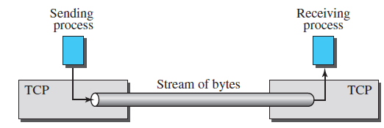
Stream Delivery Service
TCP is a stream-oriented protocol.
TCP creates an environment in which the two processes seem to be connected by an imaginary “tube” that carries their bytes across the Internet.
TCP needs buffers for storage. (the sending buffer and the receiving buffer)

Slide 21
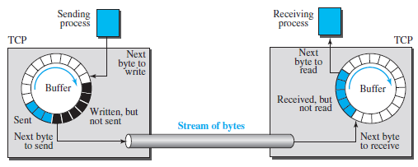
Sending and receiving buffers

Slide 22
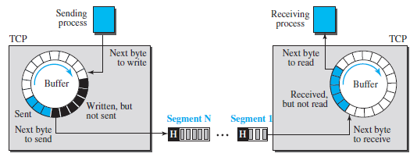
Segments
TCP to send data in packets, not as a stream of byte.
At the transport layer, TCP groups a number of bytes together into a packet called a segment.
TCP adds a header to each segment (for control purposes) and delivers the segment to the network layer for transmission.

Slide 23
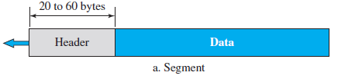
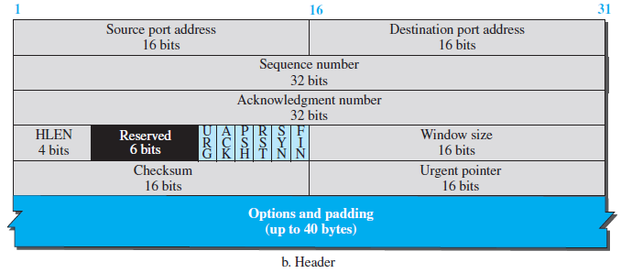
Segment
A packet in TCP is called a segment.
Format:

Slide 24
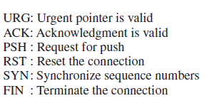
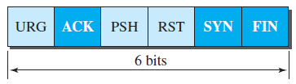
Source port address:
Destination port address:
Sequence number: 32-bit field defines the number assigned to the first byte.
Acknowledgment number: 32-bit field. If it receives x bytes, then send x+1 byte as an acknowledgment. Acknowledgement and data are piggybacked.
Control :Field defines 6 different control bits or flags

Slide 25
Header length: Indicate number of 4-byte words. The value between 5(5x4=20) and 15(15x4=60)
Window size: Length of this field is 16 bits (Max 65535 bytes)
Checksum. This 16-bit field contains the checksum.
Urgent Pointer: Valid only if the urgent flag is set.
Options. There can be up to 40 bytes of optional information

Slide 26
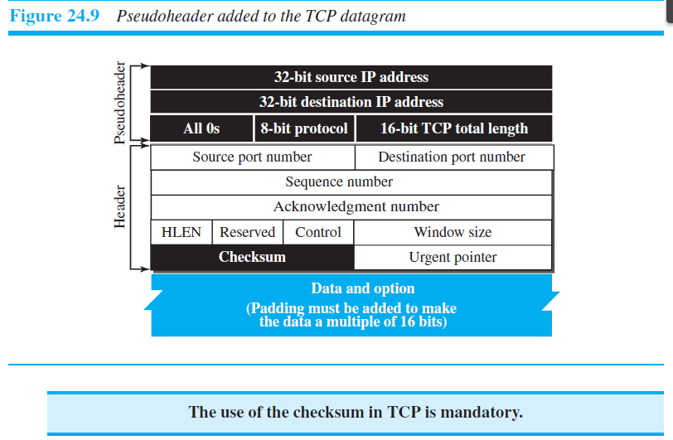
Checksum calculation

Slide 27
TCP Features
Numbering System :
  TCP software keeps track of the segments.
  Sequence number and the acknowledgment number.
  Two fields refer to a byte number and not a segment number.
Byte Number:
  Numbering does not necessarily start from 0.
  An arbitrary number between 0 and 2³² − 1 for first byte.
  Example: if the number happens to be 1057 and the total data to be sent is 6000 bytes, the bytes are numbered from 1057 to 7056

Slide 28
Sequence Number:
  TCP assigns a sequence number to each segment that is being sent.
  The sequence number of the first segment is the ISN (initial sequence number), which is a random number.
  The sequence number of any other segment is the sequence number of the previous segment plus the number of bytes

Slide 29
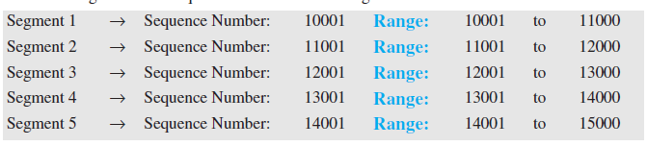
Example 24.7
Suppose a TCP connection is transferring a file of 5000 bytes. The first byte is numbered 10001. What are the sequence numbers for each segment if data are sent in five segments, each carrying 1000 bytes?
Solution:

Slide 30
Acknowledgment Number:
  The value of the acknowledgment field in a segment defines the number of the next byte a party expects to receive. The acknowledgment number is cumulative.

Slide 31
A TCP Connection
TCP is connection-oriented.
Logical path between the source and destination. Not physical path
How does TCP uses the services of IP, a connectionless protocol, to make connection-oriented?
TCP operates at higher level. Uses the services of IP to deliver segments but it controls itself.
If segments is lost, it retransmit. IP is unaware of it.
If a segment arrives out of order, TCP holds it until the missing segments arrives. IP unaware of it.

Slide 32
A TCP connection
In TCP, connection-oriented transmission requires three phases:
  Connection establishment
  Data transfer
  Connection termination.

Slide 33
Connection Establishment
TCP transmits data in full-duplex mode.
Each party must initialize communication and get approval from the other party before any data are transferred.
Three-Way Handshaking:
  A connection establishment in TCP is called Three-way handshaking

Slide 34
Connection Establishment
  Exam: Client-server communication
  Process starts with the server, the server program tells its TCP that it is ready to accept connection, This request is called Passive open.
  Client program issues a request for an active open. Client that wishes to connect to an open server tells its TCP to connect to a particular server.

Slide 35

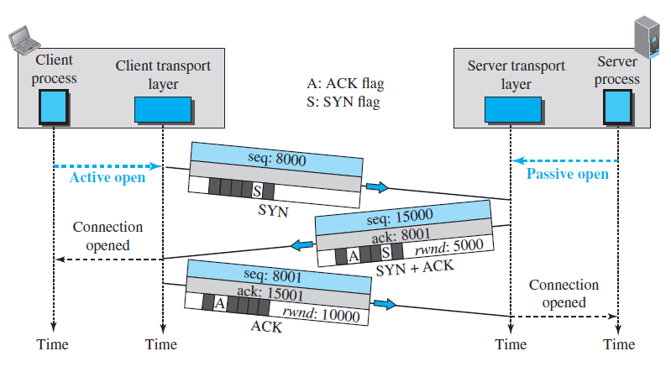
Three-Way Handshaking
Rwnd—receive window

Slide 36
The three steps in this phase are as follows:
  A SYN segment cannot carry data, but it consumes one sequence number.
  A SYN + ACK segment cannot carry data, but it does consume one sequence number
  An ACK segment, if carrying no data, consumes no sequence number.

Slide 37
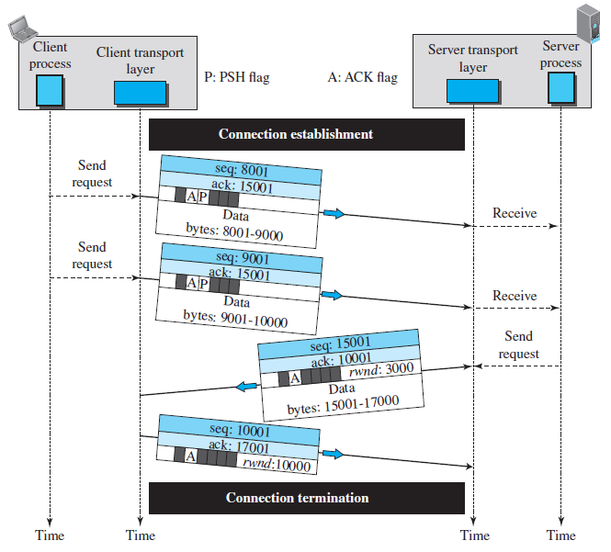
Data Transfer
The acknowledgment is piggybacked

Slide 38
Data Transfer
After connection is established, bidirectional data transfer can take place.
The client and server can send data and acknowledgments in both directions.
The acknowledgment is piggybacked with the data.
Ex.
  The client sends 2,000 bytes of data in two segments.
  The server then sends 2,000 bytes in one segment.
  The first three segments carry both data and acknowledgment.
  The last segment carries only an acknowledgment.
  Data segments sent by the client have the PSH (push) flag set

Slide 39
SYN Flooding Attack
The connection establishment in TCP is susceptible to a serious security problem called SYN flooding attack.
Malicious attackers Sending SYN segments to a server pretending that each of them are coming from different client by faking the IP addresses in the datagram
SYN flooding attack belongs to a group of security attacks known as a denial of service attack.
Some server does authentication (Verify the validity of the IP address) by using what is called cookies. SCTP uses this.

Slide 40
Pushing Data
TCP uses a buffer to store the stream of data coming.
The sending TCP can select the segment size.
Assume, Delayed transmission and delayed delivery of data may not be acceptable by the application program.
The sending TCP must not wait for the window to be filled.
The sending TCP must also set the push bit (PSH).
The receiving TCP know that the segment includes data that must be delivered to the receiving application program as soon as possible and not to wait for more data to come.

Slide 41
Urgent Data
TCP is a stream-oriented protocol.
Each byte of data has a position in the stream.
An application program needs to send urgent bytes.
Some bytes that need to be treated in a special way by the application at the other end.
The solution is to send a segment with the URG bit set.
Ex:
  If the segment sequence number is 15000 and the value of the urgent pointer is 200.
  The first byte of urgent data is the byte 15000 and the last byte is the byte 15200.
  The rest of the bytes in the segment (if present) are nonurgent.

Slide 42
Connection Termination
Either of the two parties involved in exchanging data (client or server) can close the connection.
It is usually initiated by the client.
Most implementations today allow two options for connection termination:
  Three-way handshaking
  Four-way handshaking with a half-close option.

Slide 43
Three-Way Handshaking(Termination)
In this situation, the client TCP, after receiving a close command from the client process, sends the first segment, a FIN segment in which the FIN flag is set.
The server TCP, after receiving the FIN segment, informs its process of the situation and sends the second segment, a FIN + ACK segment.
The client TCP sends the last segment, an ACK segment, to confirm the receipt of the FIN segment from the TCP server. This segment cannot carry data and consumes no sequence numbers.

Slide 44
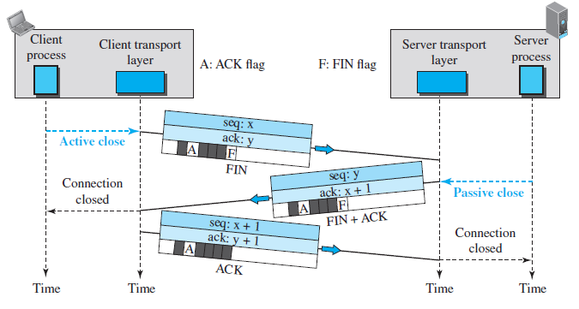
Three-Way Handshaking(Termination)

Slide 45
Half-Close
In TCP, one end can stop sending data while still receiving data. This is called a half-close.
Either the server or the client can issue a half-close request.
Good Example for Half Close is Sorting data.
The data transfer from the client to the server stops.
The client half-closes the connection by sending a FIN segment.
The server accepts the half-close by sending the ACK segment.
After half-closing the connection, data can travel from the server to the client and acknowledgments can travel from the client to the server. The client cannot send any more data to the server.

Slide 46
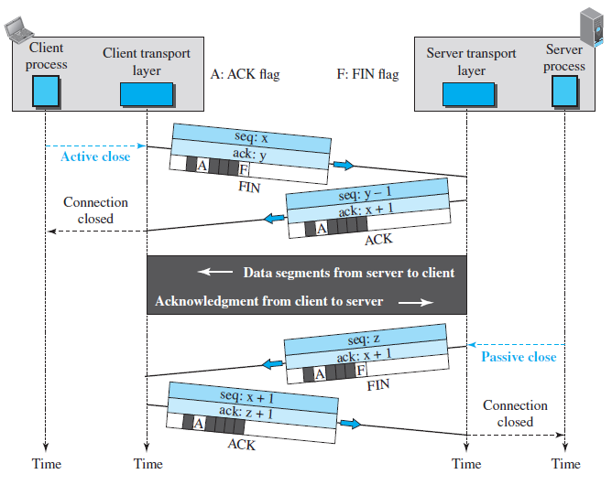
Half-close

Slide 47
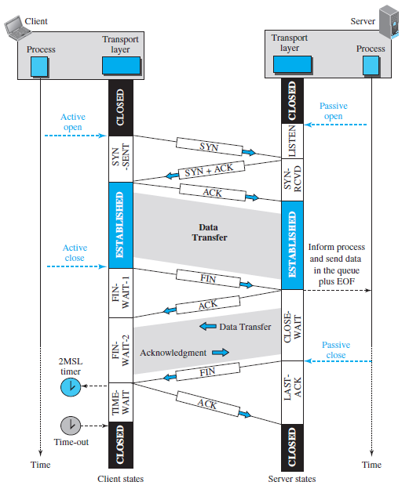
Time-line diagram for a common scenario

Slide 48
State Transition Diagram
All the different events happening during connection establishment, connection termination, and data transfer, TCP is specified as the finite state machine (FSM)
The figure shows the two FSMs used by the TCP client and server combined in one diagram.

Slide 49
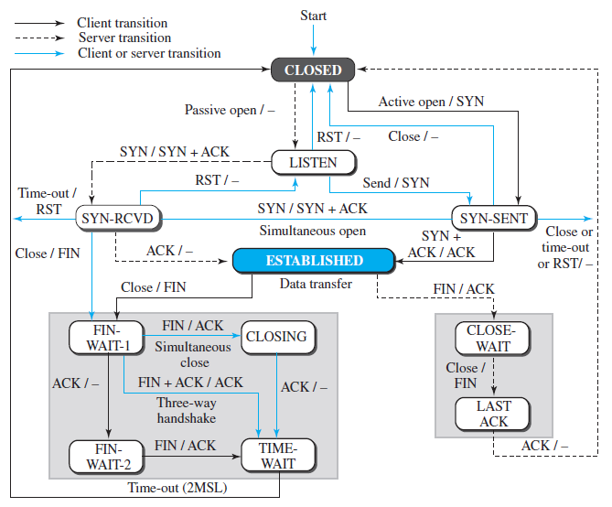
MSL-Maximum segment lifetime

Slide 50
The first string is the input, what TCP receives.
The second is the output, what TCP sends.
The colored lines show special situations.
ESTABLISHED a states, a set for the client and another for the server, that are used for flow and error control.

Slide 51
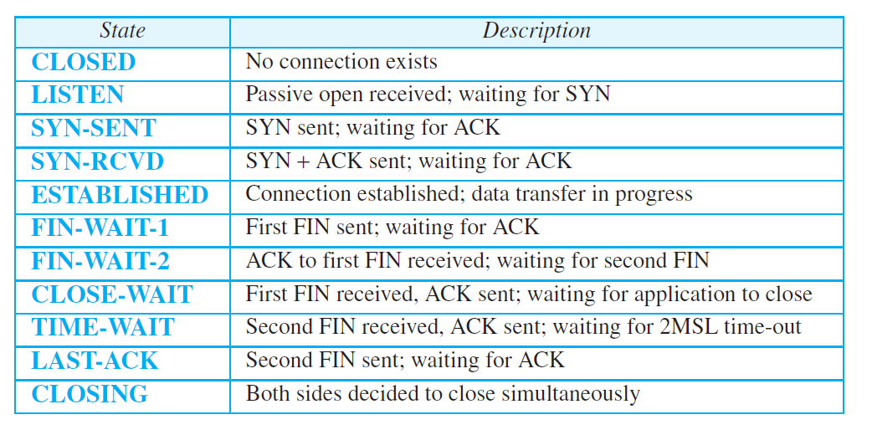
States for TCP
MSL-Maximum segment lifetime

Slide 52
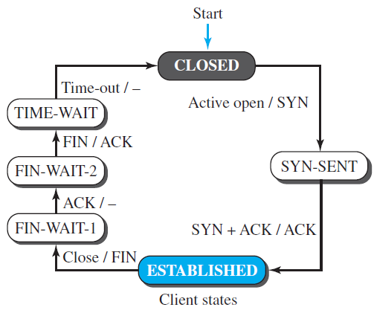
A Half-Close Scenario(Client States)
Client process issues an active open command to its TCP to request a connection to a specific socket address. string is the input, what TCP receives.
TCP sends an ACK segment and goes to the ESTABLISHED state.

Slide 53
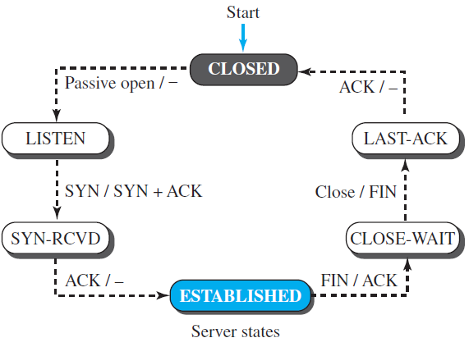
A Half-Close Scenario(Server States)
Server process issues a passive open command.
Server TCP goes to the LISTEN state and remains there passively until it receives a SYN segment.
After receiving the ACK segment, TCP goes to the ESTABLISHED state, where data transfer can take place

Slide 54
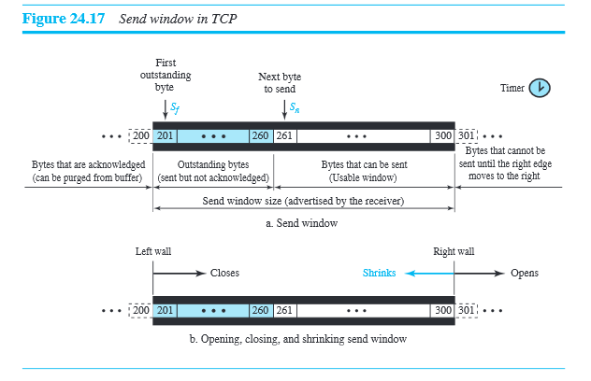
Windows in TCP
Window size is 100 bytes

Slide 55
Send window in TCP and SR protocol
Send window in same in both the cases The window size in
SR is the number of packets, but the window size in TCP is the
number of bytes. transmission in TCP occurs segment by segment,
the variables that control the window are expressed in bytes.

Slide 56
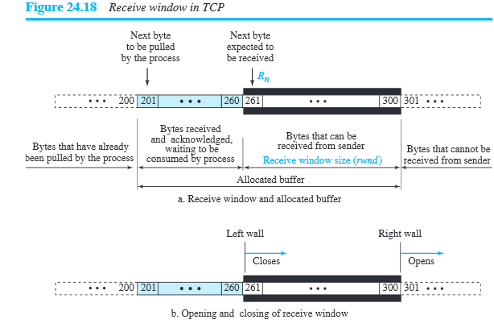
Receive Window in TCP
Rwnd=buffer size-number of waiting bytes to be pulled
acknowledgement in SR is selective, defining the uncorrupted
packets that have been received. The major acknowledgment mechanism in TCP is a cumulative acknowledgment announcing the next expected byte to receive.

Slide 57
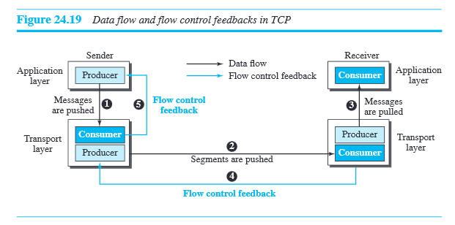
Flow control

Slide 58
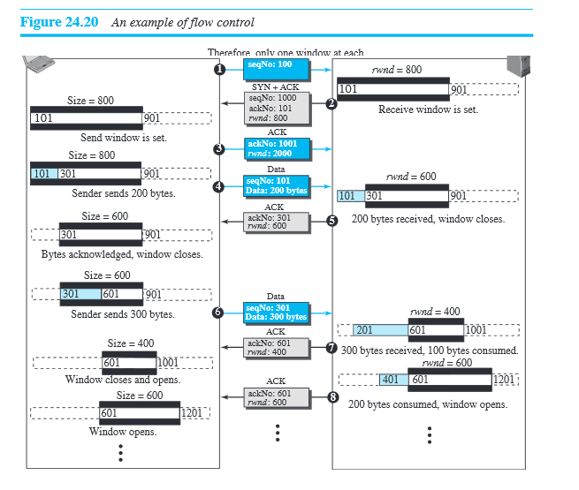
Flow control

Slide 59
Silly-window syndrome
In Sliding window operation sender may send fast but receiver may receive slowly(vice-versa).
The situation results in sending of the data in small segments, which reduces the efficiency of the operation
For example: if TCP sends segments containing only 1 byte of data, it means that a 41-byte datagram (20 bytes ofTCP header and 20 bytes of IP header) transfers only 1 byte of user data
The capacity of the network is very inefficiently used
This problem is called the silly window syndrome.

Slide 60
Syndrome created by the sender
Solution : Sending window must wait and collect large number of bytes and send in a larger block . How long should the sending window wait?
Nagel’s algorithm
1) Sending TCP sends the first piece of data even if it is only 1 byte.
2) sending TCP accumulates data in the output buffer and waits for acknowledge from the receiving TCP or until enough data have accumulated to fill a maximum size segment. At this time, the sending TCP can send the segment.
3) Step 2 is repeated for the rest of the transmission. Segment 3 is sent immediately if an acknowledgment is received for segment 2, or if enough data have accumulated

Slide 61
Syndrome created by the receiver
Two solutions have been proposed to prevent the silly window syndrome created by an application program that consumes data more slowly than they arrive.
1) Clark’s solution: send an acknowledgment as soon as the data arrive, but to announce a window size of zero until either there is enough space to accommodate a segment of maximum size or until at least half of the receive buffer is empty
2) The second solution is to delay sending the acknowledgment. This means that when a segment arrives, it is not acknowledged immediately. The receiver waits until there is a decent amount of space in its incoming buffer before acknowledging the arrived segments.

Slide 62
ERROR CONTROL
TCP is a reliable transport layer protocol. This means that an application program that delivers a stream of data to TCP relies on TCP to deliver the entire stream to the application program on the other end in order, without error, and without any part lost or duplicated.
Error control in TCP is achieved through the use of three tools: checksum, acknowledgment, and time-out.
Checksum: A field in TCP header used to check for a corrupted segment. If a segment is corrupted , the segment is discarded by the destination TCP and is considered as lost.

Slide 63
Acknowledgement Type
  TCP originally designed to acknowledge segments cumulatively.
  The receiver advertises the next byte it expects to receive ignoring all segments received and stored out of order. This is sometime referred to as positive cumulative acknowledgement or ACK. The word positive indicates that no feedback is provided for discarded, lost or duplicate segment.
  More and more implementations are adding another type of acknowledgement: Selective Acknowledgement (SACK).
  It does not replace ACK field in TCP.
  A SACK reports a block of bytes that is out of order, duplicated and received more than once. A SACK is implemented as an option at the end of the TCP header.

Slide 64
Generating ACK (Rules)
1) A sends data to B. B sends Piggyback ACK to A. This reduces the traffic.
2) If B doesn’t have data to send, it waits for another segment to arrive or until a period of time (normally 500 ms) and for both the segments ACK can be sent once . This rule reduces ACK segments
3) There should not be more than two in-order un acknowledged segments at any time. This prevents the unnecessary retransmission of segments that may create congestion
4) If segments arrive with out-of-order sequence number that is higher than expected, the receiver immediately sends an ACK segment announcing the sequence number of the next expected segment.
5) When mission segments arrive, the receiver sends an ACK segment to announce the next sequence expected.
6) If a duplicate segment arrives, the receiver discards the segment, but immediately send s an ACK indicating the next in-order segment expected,.

Slide 65
Retransmission
The heart of error control is Retransmission of segments.
The sent segment is stored in a Queue, until it is acknowledged . When the retransmission timer expires or when the sender receives three duplicate ACKs for the first segment in the queue, that segment is retransmitted .
Retransmission after RTO (Retransmission time –out)
The sending TCP maintains one RTO for each connection. When the times out TCP resend the segment in the front of the queue and restarts the timer.
RTO is dynamic in TCP and updated based on round-trip time (RTT)
RTT is the time needed for a segment to reach a destination and for an acknowledgement to be received.

Slide 66
Retransmission after Three Duplicate ACK segment
Sender can resend the segment without waiting for time out.
Most implementation today follow Three duplicate (+ one original) ACK.
This feature is called Fast retransmission
If three duplicate acknowledgement arrive for a segment, the next segment is retransmitted without waiting for the time-out

Slide 67

Note
Data may arrive out of order and be temporarily stored by the receiving TCP,
but TCP guarantees that no out-of-order data are delivered to the process.

Slide 68
Note
TCP can be best modeled as a
Selective Repeat protocol.
TCP/IP Protocol Suite

Slide 69
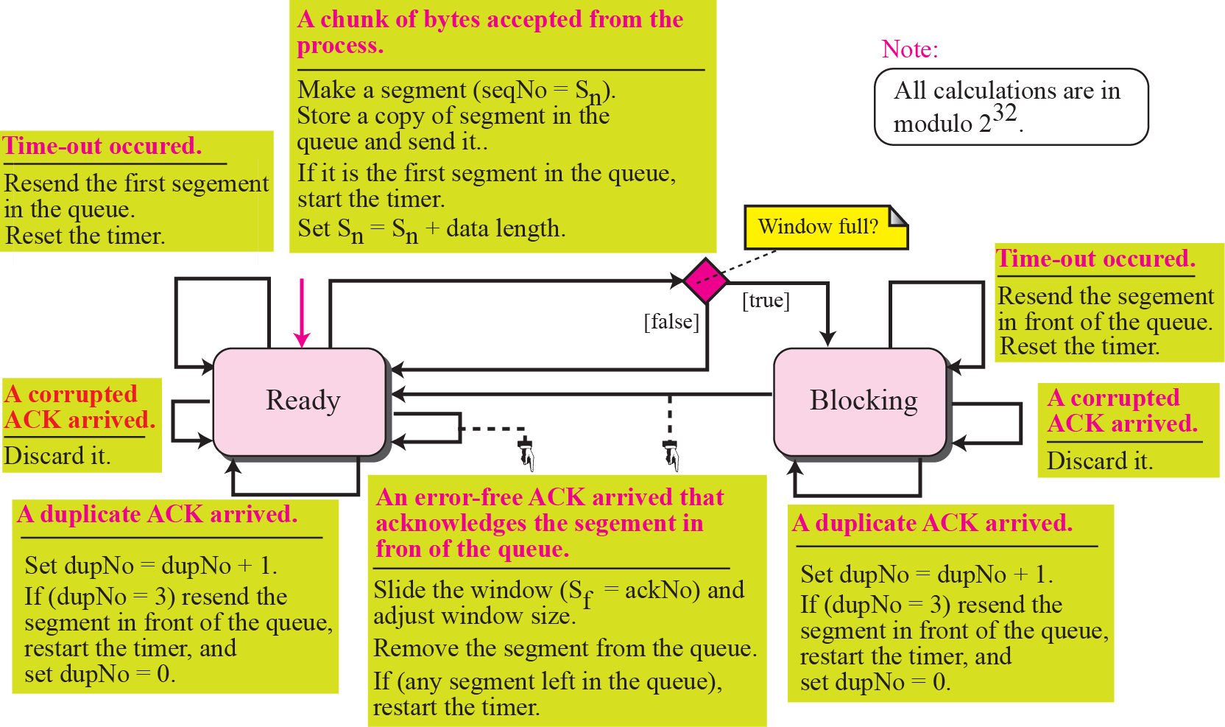
Sender side Finite State Machine _ Simplified FSM for sender site
TCP/IP Protocol Suite

Slide 70
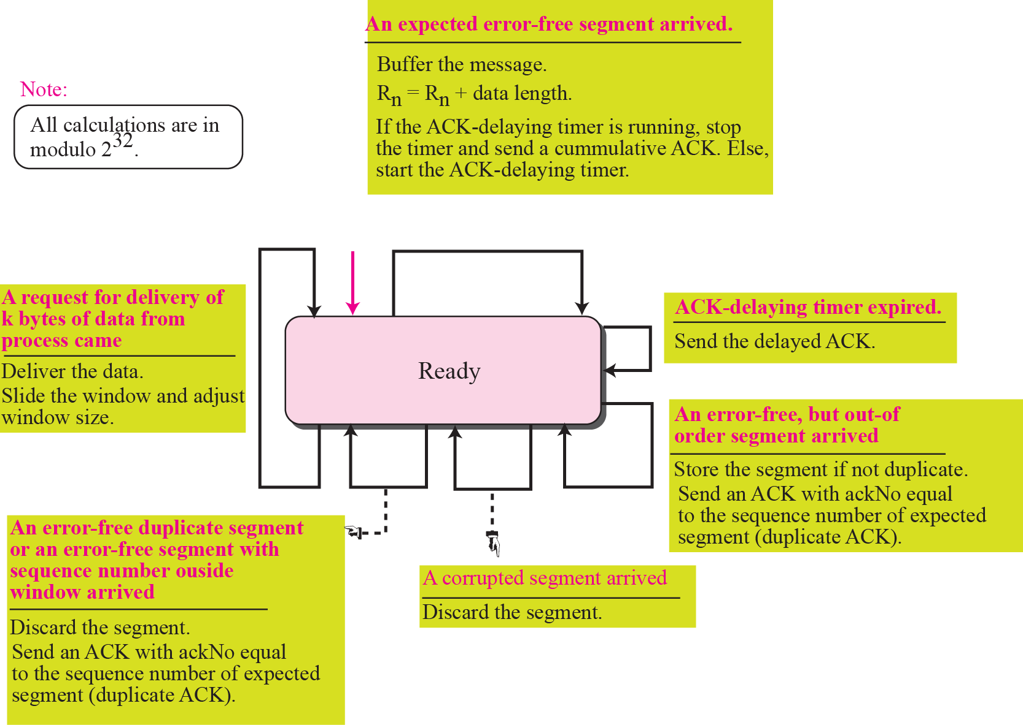
Simplified FSM for the receiver site
TCP/IP Protocol Suite

Slide 71
Generating ACK (Rules)
1) A sends data to B. B sends Piggyback ACK to A. This reduces the traffic.
2) If A doesn’t have data to send, it waits for another segment to arrive or until a period of time (normally 500 ms) and for both the segments ACK can be sent once . This rule reduces ACK segments
3) There should not be more than two in-order un acknowledged segments at any time. This prevents the unnecessary retransmission of segments that may create congestion
4) If segments arrive with out-of-order sequence number that is higher than expected, the receiver immediately sends an ACK segment announcing the sequence number of the next expected segment.
5) When missed segments arrive, the receiver sends an ACK segment to announce the next sequence expected.
6) If a duplicate segment arrives, the receiver discards the segment, but immediately send s an ACK indicating the next in-order segment expected,.

Slide 72
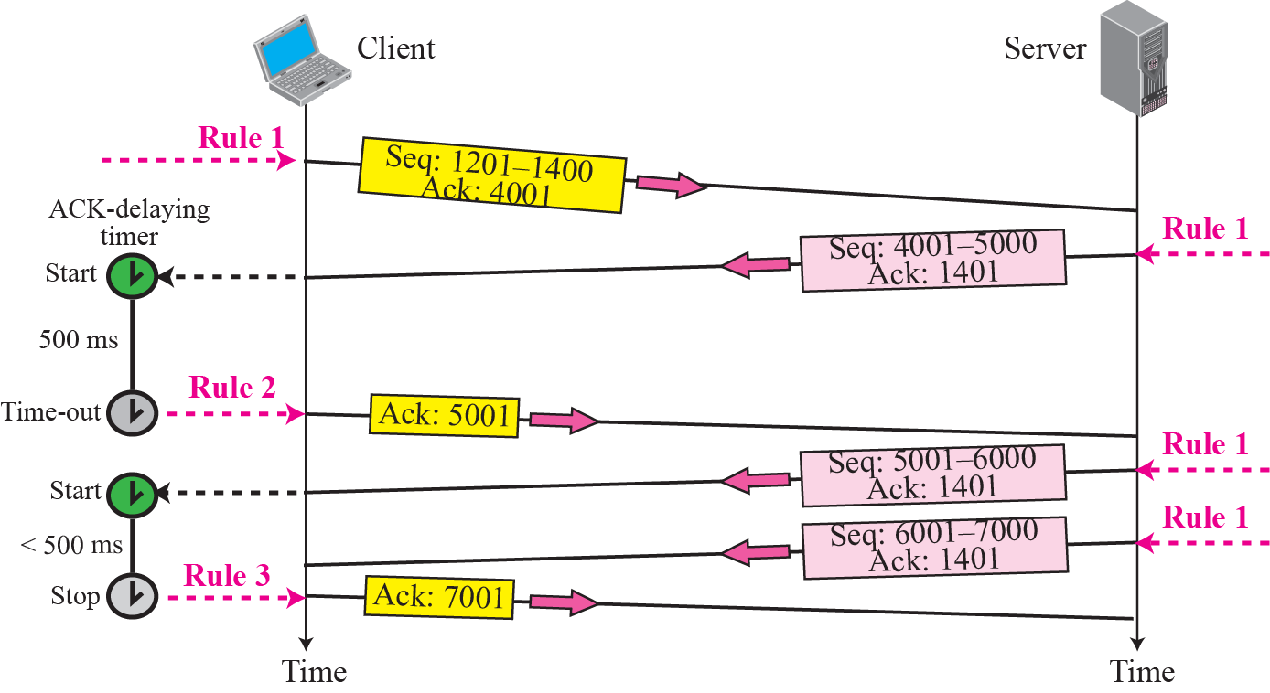
Normal operation
TCP/IP Protocol Suite

Slide 73
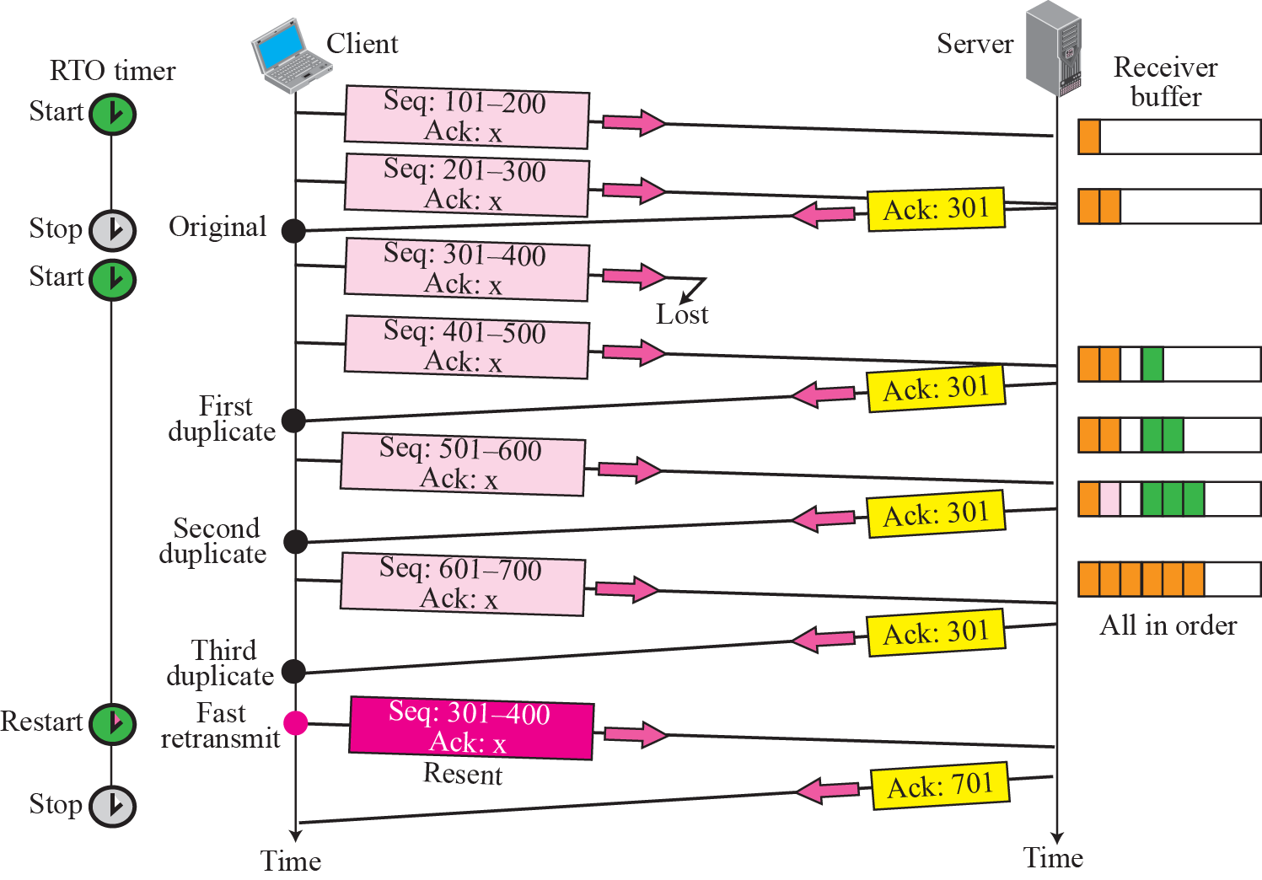
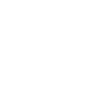




Fast retransmission
TCP/IP Protocol Suite

Slide 74
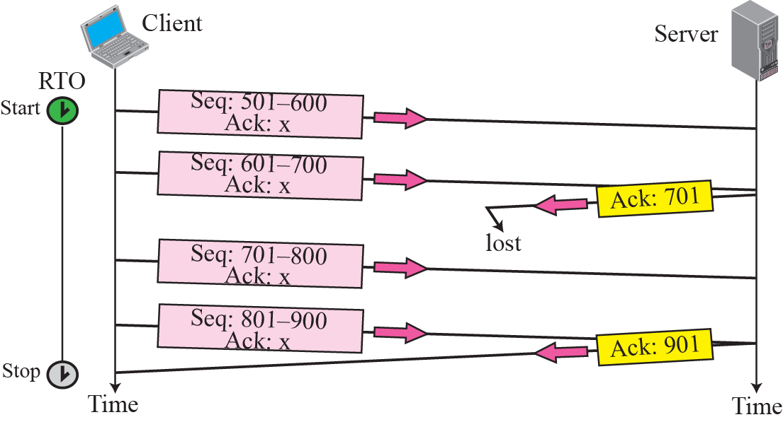
Lost acknowledgment
TCP/IP Protocol Suite

Slide 75
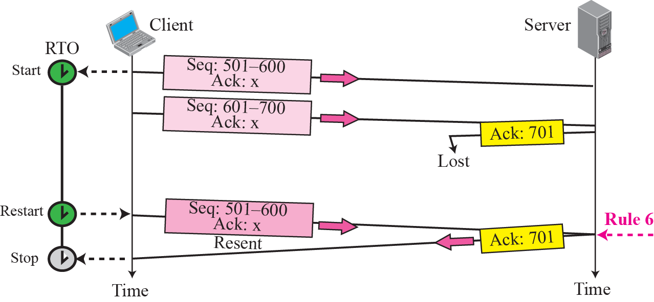
Figure 15.33 Lost acknowledgment corrected by resending a segment
TCP/IP Protocol Suite

Slide 76
CONGESTION CONTROL
We discussed congestion control in Chapter 13. Congestion control in TCP is based on both open loop and closed-loop mechanisms. TCP uses a congestion window and a congestion policy that avoid congestion and detect and alleviate congestion after it has occurred.
TCP/IP Protocol Suite

Slide 77
CONGESTION WINDOW
The size of the send window is controlled by the receive window using the value rwnd which is advertised in each segment travelling in the opposite direction
This guarantee that the receive window never overflowed (no end congestion).
But the intermediate buffers and buffers in the routers in the network may congested.
TCP need to worry about congestion in the middle

Slide 78
Congestion Window
TCP is an end-to-end protocol uses the services of IP. The congestion in the router should be taken care by IP. But, IP is a simple protocol with no congestion control. TCP itself needs to be responsible for this.
To control the number of segments to transmit , TCP uses another variable called a congestion window, cwnd (to control the congestion in the middle) whose size is controlled by the congestion situation in the network.
The cwnd and rwnd together define the size of the send window in TCP.
The actual size of the window is the minimum of these two
Actual window size = minimum(rwnd, cwnd)

Slide 79
Congestion Detection
TCP sender uses the occurrence of two events as signs of congestion in the networks.
1) Time-out 2) Three duplicate ACKs
Congestion Policies: Handling congestion based on three policies (Algorithm)
1) slow start 2) congestion avoidance 3) fast recovery

Slide 80
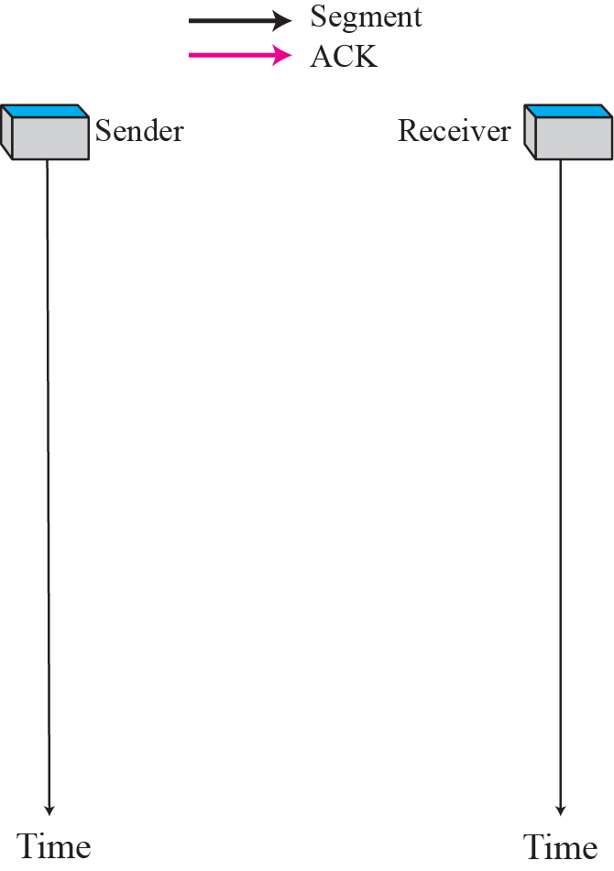
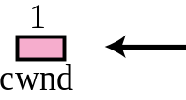
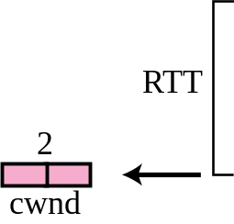
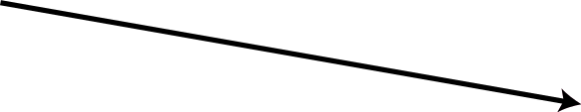

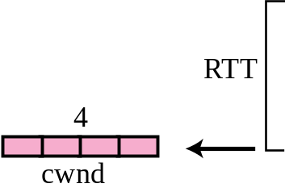
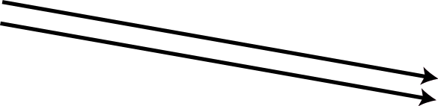
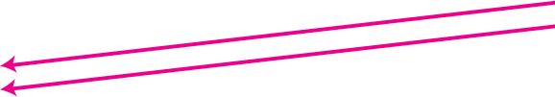
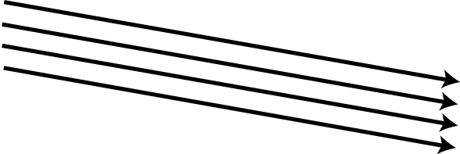
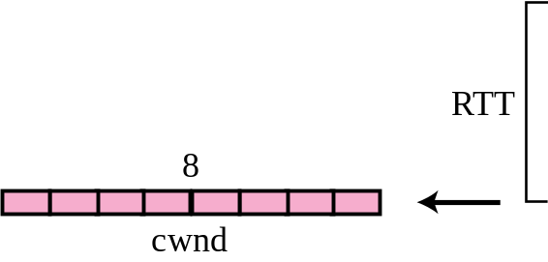
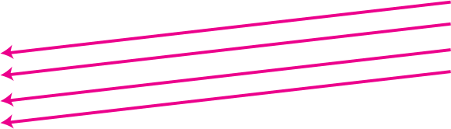
Slow start, exponential increase
MSS-Maximum segment size
Rwnd > cwnd
send window=cwnd

Slide 81
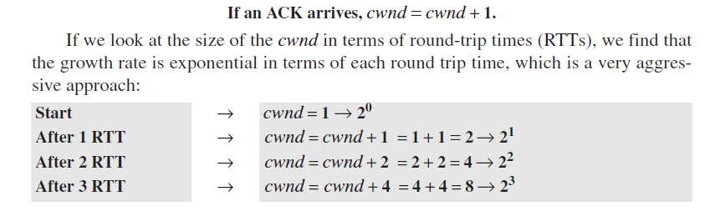
Slow start, exponential increase
Disadvantage: Slower in the case of delayed acknowledgment

Slide 82
Note
In the slow start algorithm, the size of the congestion window increases exponentially until it reaches a threshold.
TCP/IP Protocol Suite

Slide 83
Congestion Avoidance: Additive increase
If we continue with the slow start algorithm, the size of the congestion window increases exponentially.
To avoid congestion before it happens, we must slow down this exponential growth.
The congestion avoidance algorithm increases the cwnd additively instead of exponentially.

Slide 84
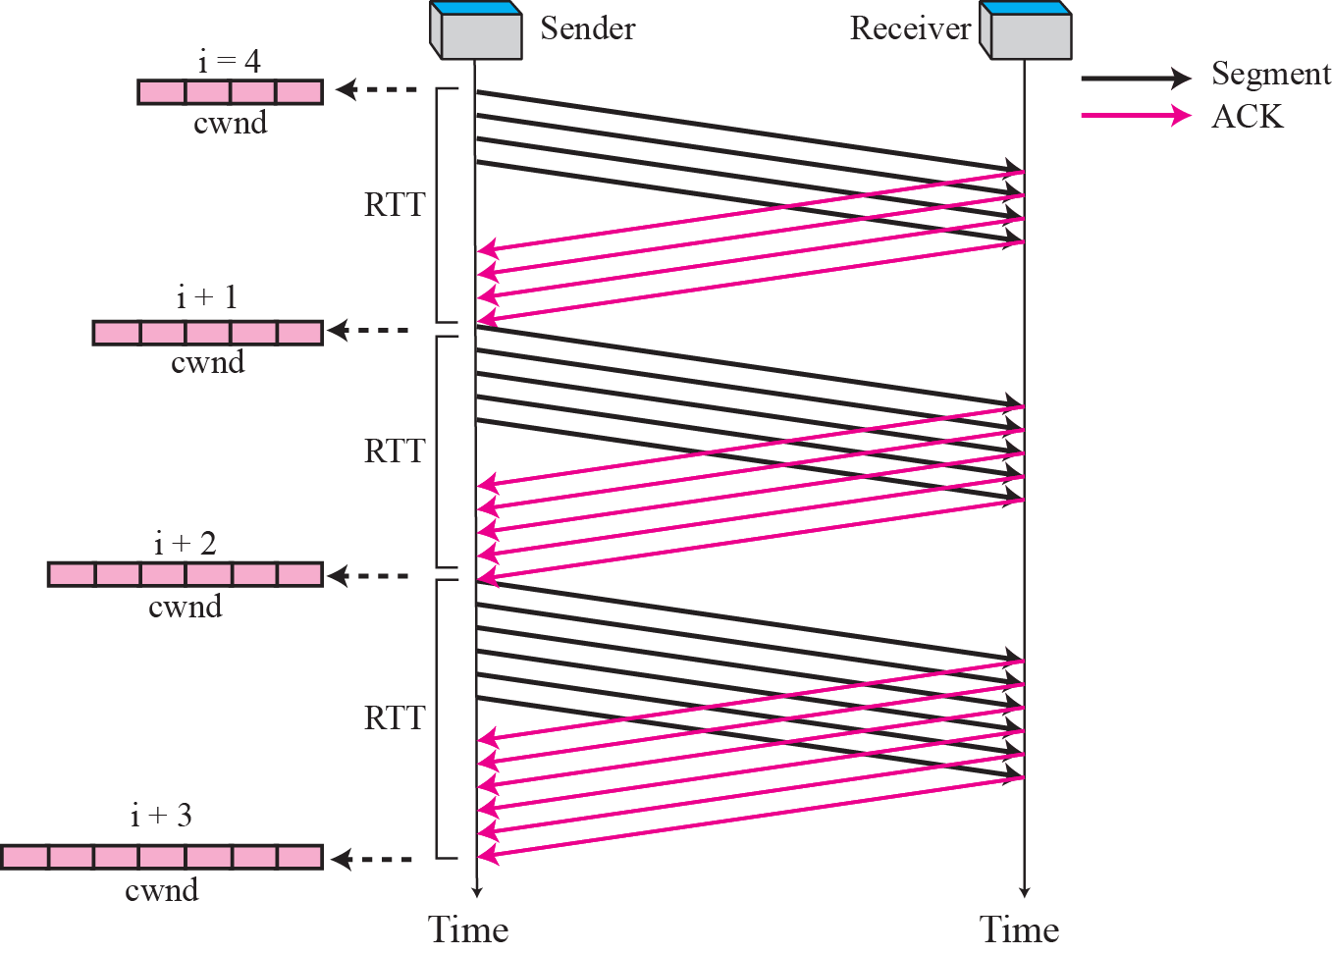
Congestion avoidance, additive increase
TCP/IP Protocol Suite

Slide 85
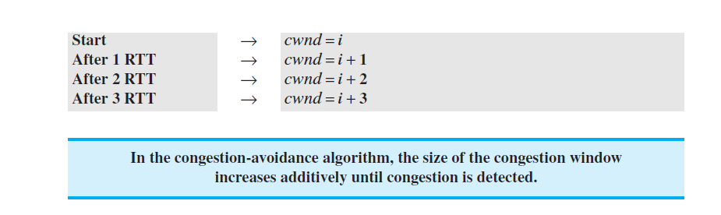
Congestion avoidance, additive increase

Slide 86
Fast Recovery
This algorithm is optional in TCP.
It starts when three duplicate ACKs arrive, which is interpreted as light congestion in the network.
Like congestion avoidance, this algorithm is also an additive increase.
It increases the size of the congestion window when a duplicate ACK arrives
If a duplicate ACK arrives, cwnd=cwnd+(1/cwnd)

Slide 87
Policy Transition
The question is when each of the policies are being use .
When TCP moves from one policy to another.
To answer to the above questions, we need to refer to three versions of TCP.
1) Taho TCP 2) Reno TCP 3) new Reno TCP

Slide 88
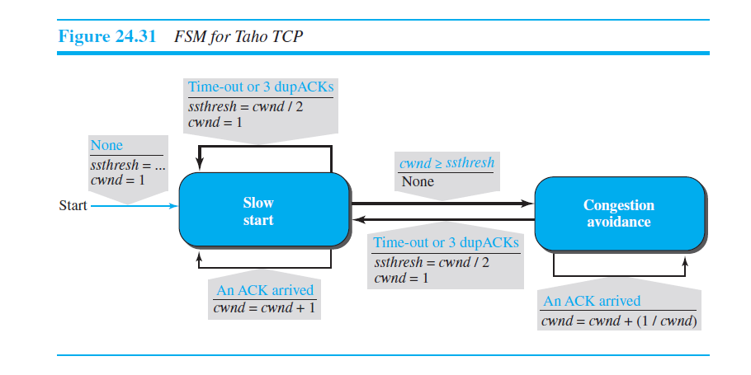
Taho TCP
It uses slow start and congestion avoidance algorithms.
TCP starts with slow start and sets the ssthresh (slow start threshold) variable to a pre agreed value (multiple of MSS)
Cwnd=1MSS (Maximum segment size)

Slide 89
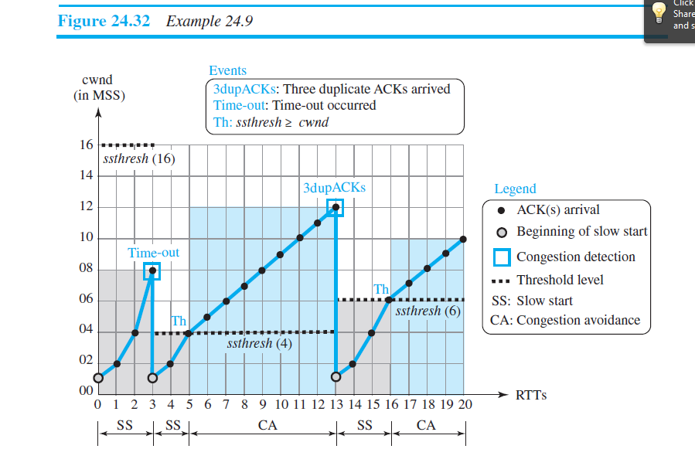

Slide 90
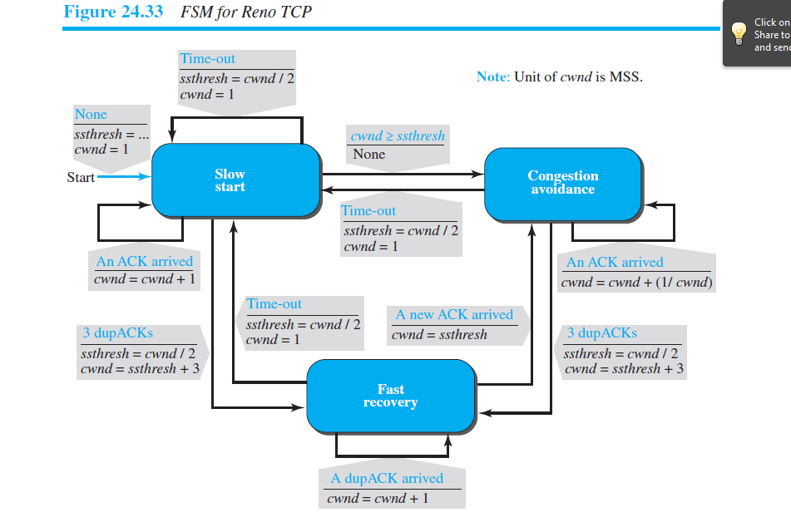
Reno TCP

Slide 91


Slide 92
TCP Timer
TCP implementation uses four types of timers : 1) Retransmission 2) Persistence 3) keep alive 4) Time-Wait
Retransmission Timer
When TCP sends the segment in front of the sending queue, it starts the timer.
When the timer expires, TCP resends the first segment in front of the queue, and restarts the timer.
When a segment or segments are cumulatively acknowledged, the segment or segments are purged from the queue.
If the queue is empty, TCP stops the timer; otherwise, TCP restarts the timer.

Slide 93
Round-Trip Time (RTT)
To calculate Retransmission Time out (RTO), we first need to calculate RTT
In TCP, the following steps to be followed to calculate RTT:
Measured RTT: We need to find how long it takes to send a segment and receive an acknowledgment for it. This is the measured RTT
Note that in TCP only one RTT measurement can be in progress at any time.
Smoothed RTT : The measured , RTTM, is likely to change for each round trip. The fluctuation is so high in today’s Internet that a single measurement alone cannot be used for retransmission time-out purposes.
Most implementations use a smoothed RTT, called RTTS, which is a weighted average of RTTM and the previous RTTS, as shown below:

Slide 94


Slide 95


Slide 96


Slide 97



Slide 98
Self-study
Karn’s algorithm
Persistence timer
Keep-alive timer
Time-out timer

